Slide 1
A PlanNet Marketing Training
7 SKILLS TO BECOME A
PROFESSIONAL NETWORK MARKETER
Skill #7: Promoting Events

Slide 2
02
A NETWORK MARKETING PROFESSIONAL
A person who is an expert at the skills required to build a large and successful Network Marketing organization

Slide 3
7 SKILLS TO BECOME A
PROFESSIONAL NETWORK MARKETER
Go Pro Book – by Eric Worre
PROMOTING
EVENTS
HELPING
PARTNER GET STARTED
5. HELPING
PROSPECT TO BECOME A PARTNER
4. FOLLOWING
UP
3. PRESENTING
OPPORTUNITY
2. INVITING
PROSPECTS
1. FINDING
PROSPECTS

Slide 4
SEVEN SKILLS TO BECOMING A NETWORK MARKETING PROFESSIONAL
SEVEN SKILLS YOU MUST MASTER IN ORDER TO BECOME A NETWORK MARKETING PROFESSIONAL
Finding prospects
Inviting prospects to understand your product or opportunity
Presenting your product or opportunity to your prospects
Following up with your prospects
Helping your prospect become customers or distributors
Helping new distributors get started right
Grow your team by promoting events

Slide 5
LEADERS ARE BORN AT EVENTS
THE KEY TO YOUR PROMOTION
PROMOTION
IS IN YOUR PROMOTIONS
Get people better than you to events bigger than

Slide 6
OBJECTIVE
Your ability to get more and more people out to events
Your ability to get more sales throughout your organization
Your ability to get people promoted to the next pin level

Slide 7
FOCUS ON PROMOTION
PROMOTE
verb (used with object), promoted, promoting.
To Advance In Rank, dignity, position, etc.
(opposed to demote)
(For you to go to the next pin level)
To Encourage The Sales, acceptance, etc., of (a product), especially through advertising or other publicity.
(the sale of your business – Rep / ITA)
Education, to put ahead to the next higher
stage or grade of a course or series of classes, training.
(Event, convention, call, webinar)

Slide 8
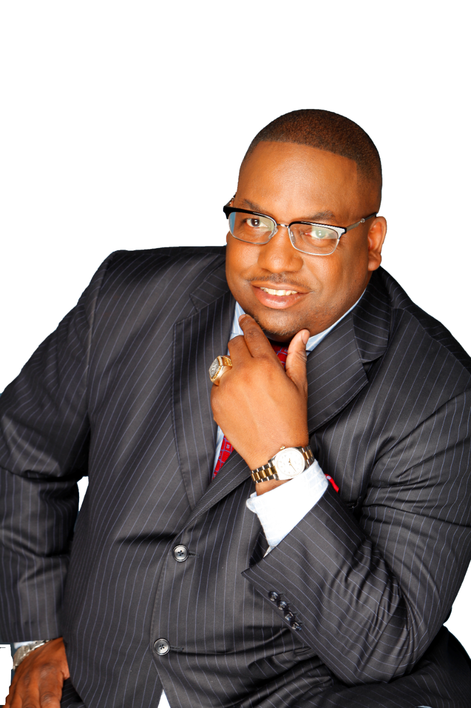
“YOUR PROMOTION
TO THE NEXT
LEVEL
IS TIED
UP IN YOUR
PROMOTIONS.”
SHEDRICK WHITE

Slide 9
As a PROMOTER you have to create a sense of urgency in!
To promote is to describe the features and benefits of attending.
Reward what you want repeated. Example: Let them know if they register early, they will be apart of a special group.

Slide 10
As a promoter you have to create a sense of urgency in!
Reward what you want repeated.
Example: Let them know if they register early, they will be apart of a special group. Describe the features and benefits of attending..

Slide 11
Your ability to get a few key people to consistently do a few simple things over an extended period-of-time
You have to have a vision to be a promoter
You have to have a game plan to get your team present
You have to have constant Communication

Slide 12
STRATEGY
Facts Tell, Stories Sell
Share stories or accounts of peoples lives whose were changed as a result of attending the event
Create fun competitive competition within your group Reward what you want repeated
Who is going to have the most guest out
Who can get the most of their teammates out

Slide 13
Market Share – what percentage of the attendee’s attending fall within your organization.
As a leader you want to have a goal to have at minimum 10-15 separate legs of your business out to the big events weekly meetings and or convention.

Slide 14
DON
KING
PROMOTOR
Promoter of over 500 World Championship fights—so far.
Nearly 100 boxers have earned $1 million or more in Don King Productions-promoted fights—so far.
Whose made the most money in Boxing and has never thrown a punch

Slide 15
RUSSELL
SIMMONS
PROMOTOR
American Entrepreneur
Co-Founder of Def Jams
television hits HBO's Def Comedy Jam and Def Poetry Jam.
Is one of the biggest promoters of music and highly successful business magnates of our time.
The third wealthiest personality in hip hop but has never
recorded a song.

Slide 16
SKILLS THAT PAY
Being a professional promoter is the highest paying of the seven skills.
You can be extremely successful if you learn to be the best promoter in PlanNet Marketing.

Slide 17
02
A NETWORK MARKETING PROFESSIONAL
Your ability to get a few key people to consistently do a few simple things over an extended period-of-time.

Slide 18
PROMOTING events is one of
the main things we do.
Events Sell
Events Recruit
Events Train
Events Glue Team Together
Events Increase Skillset
Events Take Away Excuses

Slide 19
As a PROMOTER, you want to promote upcoming events, calls, and contest to your entire team.
And teach your team to promote events.
Big events will allow prospects, to see the BIG PICTURE.

Slide 20
02
A NETWORK MARKETING PROFESSIONAL
A difference between, announcing, inviting and promoting.

Slide 21
MINDSET
OF A PROMOTER
Announcing Most people announce it! (posting a flyer)
Inviting - Getting on the phone they ask them to come out .
Promotion is another level –
Letting people know the value and the benefit of attending..
Telling people that you are committed to it.

Slide 22
DR DRE
PERFORMER
PRODUCER
PROMOTOR

Slide 23
As a performer you have to be willing to go out and do the work.
Every chance you get you are out showing the business.
Spend a lot of time in the studio.
Willing to put in a lot of hours in perfecting your skills.
Get really good at what you are doing.
Take every opportunity to showcase talent.
PERFORMER

Slide 24
Producer: people are attracted to your success.
Who are you producing?
You aren’t a leader until you reproduce yourself.
If you are bronze who are you helping become bronze?
If you are director who are you helping to become director?
Producer are performers who simply help someone else have success.
The PRODUCER makes more then the Performer.
PRODUCER

Slide 25
Wealthy people look for and build Networks
Promoter understand the power of leverage, they host the concert with the top performers and get paid from everyone in the building.
They have leaders who are producing leaders.
Producers focus on becoming promoters they are focused on “Market Share,”
They promote multiple events
Promoters who are producers and performers earn the most!
PROMOTER

Slide 26
Becoming a
WORLD CLASS PROMOTER
You must be committed to the process of promotion - you have to be more committed than anyone else. It takes laser focus.
You must demonstrate your commitment –
Register first, you can’t expect people to do what you haven’t done. Demonstrate that you are more committed than anyone else.
Create a verbal commercial - you need to have a little commercial of why they should come.
TYLER PERRY
PERFORMER
PRODUCER
PROMOTER

Slide 27
AS A LEADER YOU SHOULD MEASURE.
ARE YOU GROWING FROM EVENT TO EVENT?
Are you tracking the attendance?
How many people attended?
How many guest did you and your team have out?
How many enrollments did you and your team have?
How many teammates did you get out to attend big event?
Is your attendance growing or going backwards?
Give a reward or incentive- the person who has most team members to show up

Slide 28
WHY SHOULD YOU PROMOTE TO BIG EVENTS
Big Events dispels the excuses of the weak minded.
Big Events Build the Team Culture.
Big Events challenge the non-producers to become producers.
Increases confidence by increasing the competence.
Big Meetings allow you to recruit the open-minded people.
Big Meetings renews the vision of the distracted.
Big Events dispels the excuses of the weak minded.
Important way to measure team growth. As a business owner there are two times that you should be concerned.
When your attendance drops, quality of your business drops.
The quality of the people you bring in
Big Meetings renews the vision of the distracted.

Slide 29
HOW TO BECOME A MASTER PROMOTER
Promotion Is Repetitive, Constant, Enthusiastic, Excited, All Inclusive, Benefit Oriented.
If you want people to come, you have to be able to share what you are going to receive when you attend this event, training, travel party.
Create a verbal commercial.

Slide 30
WAYS TO UTILIZE ONLINE TO PROMOTE YOUR BUSINESS
Social Media Pages
Facebook Groups
Special Interest Groups
Stories
Highlights
Info Graphics – Professional images
Online Webinars / Zoom
Consistent Promotions
Advertise Budget
Promoting your product
Taking Pictures with influencers

