Slide 1
UNDERSTAND YOUR COLORS
TO MASTER
YOUR PS3

Slide 2
BY KNOWING YOUR PROSPECTS PERSONALITY COLOR
YOU CAN BETTER GUIDE THEM THROUGH THE PS3.
SO…FOLLOW THE S.Y.S.T.E.M
SAVE YOUR SELF . . .
MONEY
TIME
ENERGY

Slide 3
UNDERSTANDING THE COLORS
GREENS
Everyone is DIFFERENT
You will prospect different personalities
and lead different personalities.
You must be in the business of people.
Master who they are, how they think, what
motivates or demotivates them.
We have placed people in
4 personality colors:
BLUES
YELLOWS
REDS

Slide 4
STRATEGIES AND SOLUTIONS FOR BLUES
PROS:
People love them and they love people.
The fun people/ the life of the party.
Great presenters.
High energy/ charismatic/ flashy/ sharp dressers.
Blues must Understand…
How to MASTER the MUNDANE.
Not everyone loves your playful personality and free spirit. Know when it is appropriate.
Take this business more seriously. It could save your life.
You must learn to focus for long periods of time. Stop starting and stopping.
Personal Development will help you with focus.
And make this business fun.
CONS:
When it gets hard or boring they loose interest.
Lack of focus for long periods of time.
Love to turn up…all the time!
Blue

Slide 5
STRATEGIES AND SOLUTIONS FOR RED
PROS:
Driven
Money motivated
Influential and will drive your numbers.
Reds must Understand….
Everyone is not in this business to make money.
Your passion and fire may be too much for some people. Passion with Poise!
PUT THE MACHINE GUN DOWN! You will kill your business with insensitivity.
Be EMPATHETIC
Personal Development will help you sustain longevity.
You will get there and it doesn’t have to be NOW. Its ok.
Understand everyone matters!
CONS:
Alpha personality traits
Recognition driven
Could be blunt and Insensitive
May be hard to coach. They know it all.
Red

Slide 6
STRATEGIES AND SOLUTIONS FOR YELLOW
Yellows must Understand…
DON’T TAKE EVERYTHING SO PERSONAL.
Your over sensitivity will kill momentum.
Recover quicker!
Stop getting caught up in outside drama with family and friends.
It’s ok to step on a toe, it’s ok to push people, correct them, teach them and lead them. Your team doesn’t always need a buddy, they need a leader.
Your desire for NON-CONFRONTATION may create doubt in your team that you can lead them.
Understand that your dreams, and your goals matter too.
Personal Development will help you with your emotions, lack of urgency and meeting your goals
PROS:
They love people
Very kind. They care deeply for people and their feelings
Very loyal
Servant leaders
CONS:
SLOW moving
May be sensitive to correction or rejection
May get stuck easily
Yellow

Slide 7
STRATEGIES AND SOLUTIONS FOR GREENS
Greens must Understand…
Your over analytical mindset is not that of everyone else's mindset.
Stop getting ready to get ready.
Asking 1000 questions may be troublesome to others.
Everyone does not need all the details like you.
Don’t find yourself recreating modules, sheets, binders, busy work and paperwork for your team.
Your team WILL GET STUCK and never get going. You can never get momentum giving them tons of homework.
Try not to be judgmental and over analyze everything and everyone.
Loosen up, go with the flow and have fun!
PROS:
Educated and informed.
Smart/ Sharp/ Intellectual
Organized and timely.
Very loyal and long suffering.
CONS:
EXTREMELY analytical
Slow moving. Getting ready to get ready.
Can be Judgmental
Green

Slide 8
UNDERSTAND DIRECT vs INDIRECT
INDIRECT
BEHAVIOR
DIRECT
BEHAVIOR
Approach risk cautiously
Extremely patient
Longer to make decisions
Not quick to speak, never dominating the conversation
Asks for permission not forgiveness
Gentle handshake, softer spoken
Very Non confrontational
Not afraid of risks
Quick to make decisions, trusts their gut
Don't need permission to speak.
they jump in the conversations
May even dominate the conversation
Asks for forgiveness not permission
Animated and loud spoken
Impatient and not afraid of conflict

Slide 9
P
PIQUE INTEREST
Purpose is to set an appointment
to share the plan
Do NOT explain the business
Ask a question to get a “YES”

Slide 10
FOR WARM MARKET PROSPECTS: “You’ve been wildly successful, and I’ve always respected the way you’ve done business.” “You’ve always been so supportive of me and I appreciate that so much.” “You’re one of the most connected people I know, and I’ve always admired that about you.”
SINCERELY COMPLIMENT
THE PROSPECT
FOR COLD MARKET PROSPECTS: “You’ve given me/us some of the best service I’ve/we’ve ever received.” “You are super sharp. Can I ask what you do for a living?” “You’ve made ________ a fantastic experience.”

Slide 11
POWERFUL QUESTIONS…
LEAD TO MORE OPPORTUNITIES
Do you or anyone you know travel on occasion?
Knowing what you know about Priceline today, would you have invested in that company 20 years ago?
When it comes to earning extra income, do you keep your options open?
I found a way to save money and make money on travel, something I’m going to do anyway.
Would you be open to take a look?

Slide 12
S
SHOW THE PLAN
Expose the opportunity to
your Prospect
Be Professional
Be Timely

Slide 13
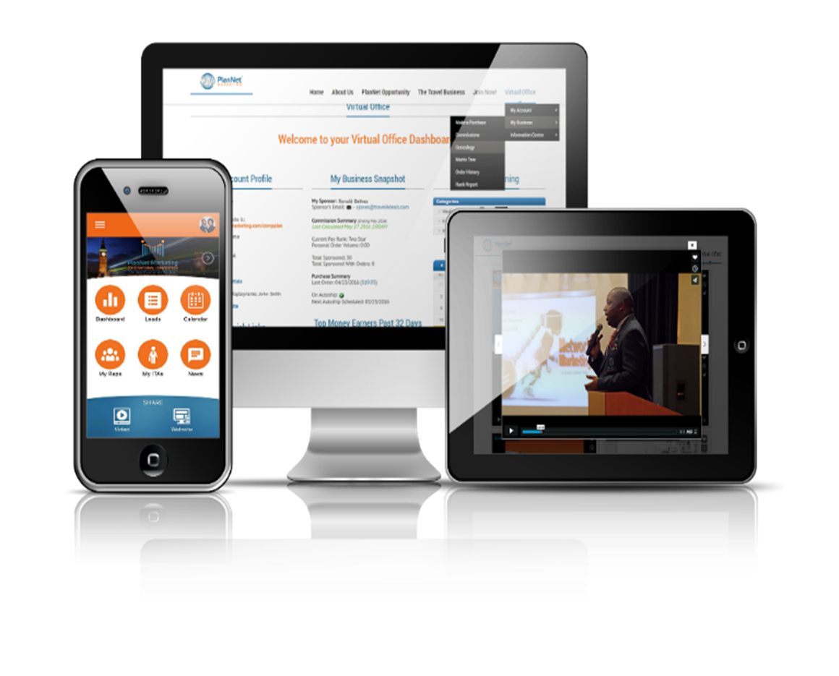
Different options for sharing the plan:
PlanNet Marketing Mobile App Video Share
Invite to a weekly meeting
Invite to listen to a live conference call
Invite to listen to the On-Demand Call
Invite to a Travel Party
Flipchart / Corporate PowerPoint
Presentation

Slide 14
HOW DOES THAT CONVERSATION LOOK?
VIDEO
Travel Party or Webinar
Q: When is a good time for you to watch this short video?
If it’s not definitive “I’ll try to do it sometime”, then tell them. “I don’t want to waste your time or mine. Why don’t we just try to lock in a time you’ll have seen it for sure?”
DON’T SUGGEST A TIME FOR THEM.
A: Awesome!, So you’ll be able to watch it by __________?
Great! I will send it over and then call at ______________.
What’s the best number and time for me to call?
CALL ON TIME!
Great! I am having an EXCLUSIVE event at my home (or online) on _____________
I would love for you to be my guest; can I count on you to attend for support?
Thank you! I will forward you the information. And I can not wait to see you.
NOTE: Have another Business Partner follow up with them or you follow up with them the day before to confirm.
QUESTIONS AFTER THE EXPOSURE
What did you like best? Then, Agree (Me too!)
Level of 1-10, where do you see yourself? (7 and above = 3-way call)

Slide 15
DON’T SUGGEST A TIME FOR THEM. Ask the question and have them give you the time. If it’s not definitive “I’ll try to do it sometime”, then tell them. “I don’t want to waste your time or mine. Why don’t we just try to lock in a time you’ll have seen it for sure?”
THE KEY IS TO GET THEM TO SAY YES, A SECOND TIME.

Slide 16
AVOID THESE MISTAKES
DO NOT Explain or over sensationalize the Business
DO NOT Send information without a confirmation of availability
DO NOT Send information without piquing interest

Slide 17
3
3 WAY CALL
THE MOST
OVERLOOKED STEP

Slide 18
WHY IS THE 3 WAY
CALL IMPORTANT?
Third Party Validation close the deals for you
Your prospect may trust you but still need validation from someone else, because you are new
This process is easily duplicated in your organization
Saves time chasing the rabbit
The leader will edify you and confirm the decision you made

Slide 19
PREPARE FOR THE CALL
Who do I do a 3-way call with?
Set An Appointment
Edify who they will hear from: -He/She is having fun -He/She loves helping people -He/She is showing people how to earn a full-time
income on a part time basis -He/She have 100% of the information

Slide 20
HOW TO CONDUCT THE CALL
Edify your 3 Way Call Leader prior to adding them on the line
Always CALL your Prospect FIRST
Once on the call, Make the brief introduction
Prospect’s First & Last Name
Leader’s Salutation - Mr. or Ms.
Keep Your Phone on MUTE
Take Notes During the call & have your calendar in hand
Follow Up Date is provided

Slide 21
HELPFUL TIPS
MERGING CALL TIPS
FOLLOW UP is KEY!
DO NOT Ask if you can get your leader on the call
Edify the Leader & Say “They’re so busy I’m not sure if I can get them on the call, HOLD ON” & click over
DO NOT Edify your prospect to the leader on the call
Tell the 3-way call leader what the prospect Liked Best, before merging the call
The Prospect may not say YES the first time
They may ask you to follow up at a later date
They may offer REFERRALS of other interested parties
There’s FORTUNE in the follow up
A 3-way call is not necessary for the follow up

Slide 22
Thank You

