Slide 1
A PlanNet Marketing Training
7 SKILLS TO BECOME A
PROFESSIONAL NETWORK MARKETER
Skill #4: Follow Up

Slide 2
02
A NETWORK MARKETING PROFESSIONAL
A person who is an expert at the skills required to build a large and successful Network Marketing organization.

Slide 3
7 SKILLS TO BECOME A
PROFESSIONAL NETWORK MARKETER
Go Pro Book – by Eric Worre
PROMOTING
EVENTS
HELPING
PARTNER GET STARTED
5. HELPING
PROSPECT TO BECOME A PARTNER
4. FOLLOWING
UP
3. PRESENTING
OPPORTUNITY
2. INVITING
PROSPECTS
1. FINDING
PROSPECTS

Slide 4
As a professional, you need to understand this skill. The Fortune is in the Follow up. This skill is responsible for you getting paid. You don’t make money for approaching people, you make money when you get them to a presentation, follow up, and get them signed up.

Slide 5
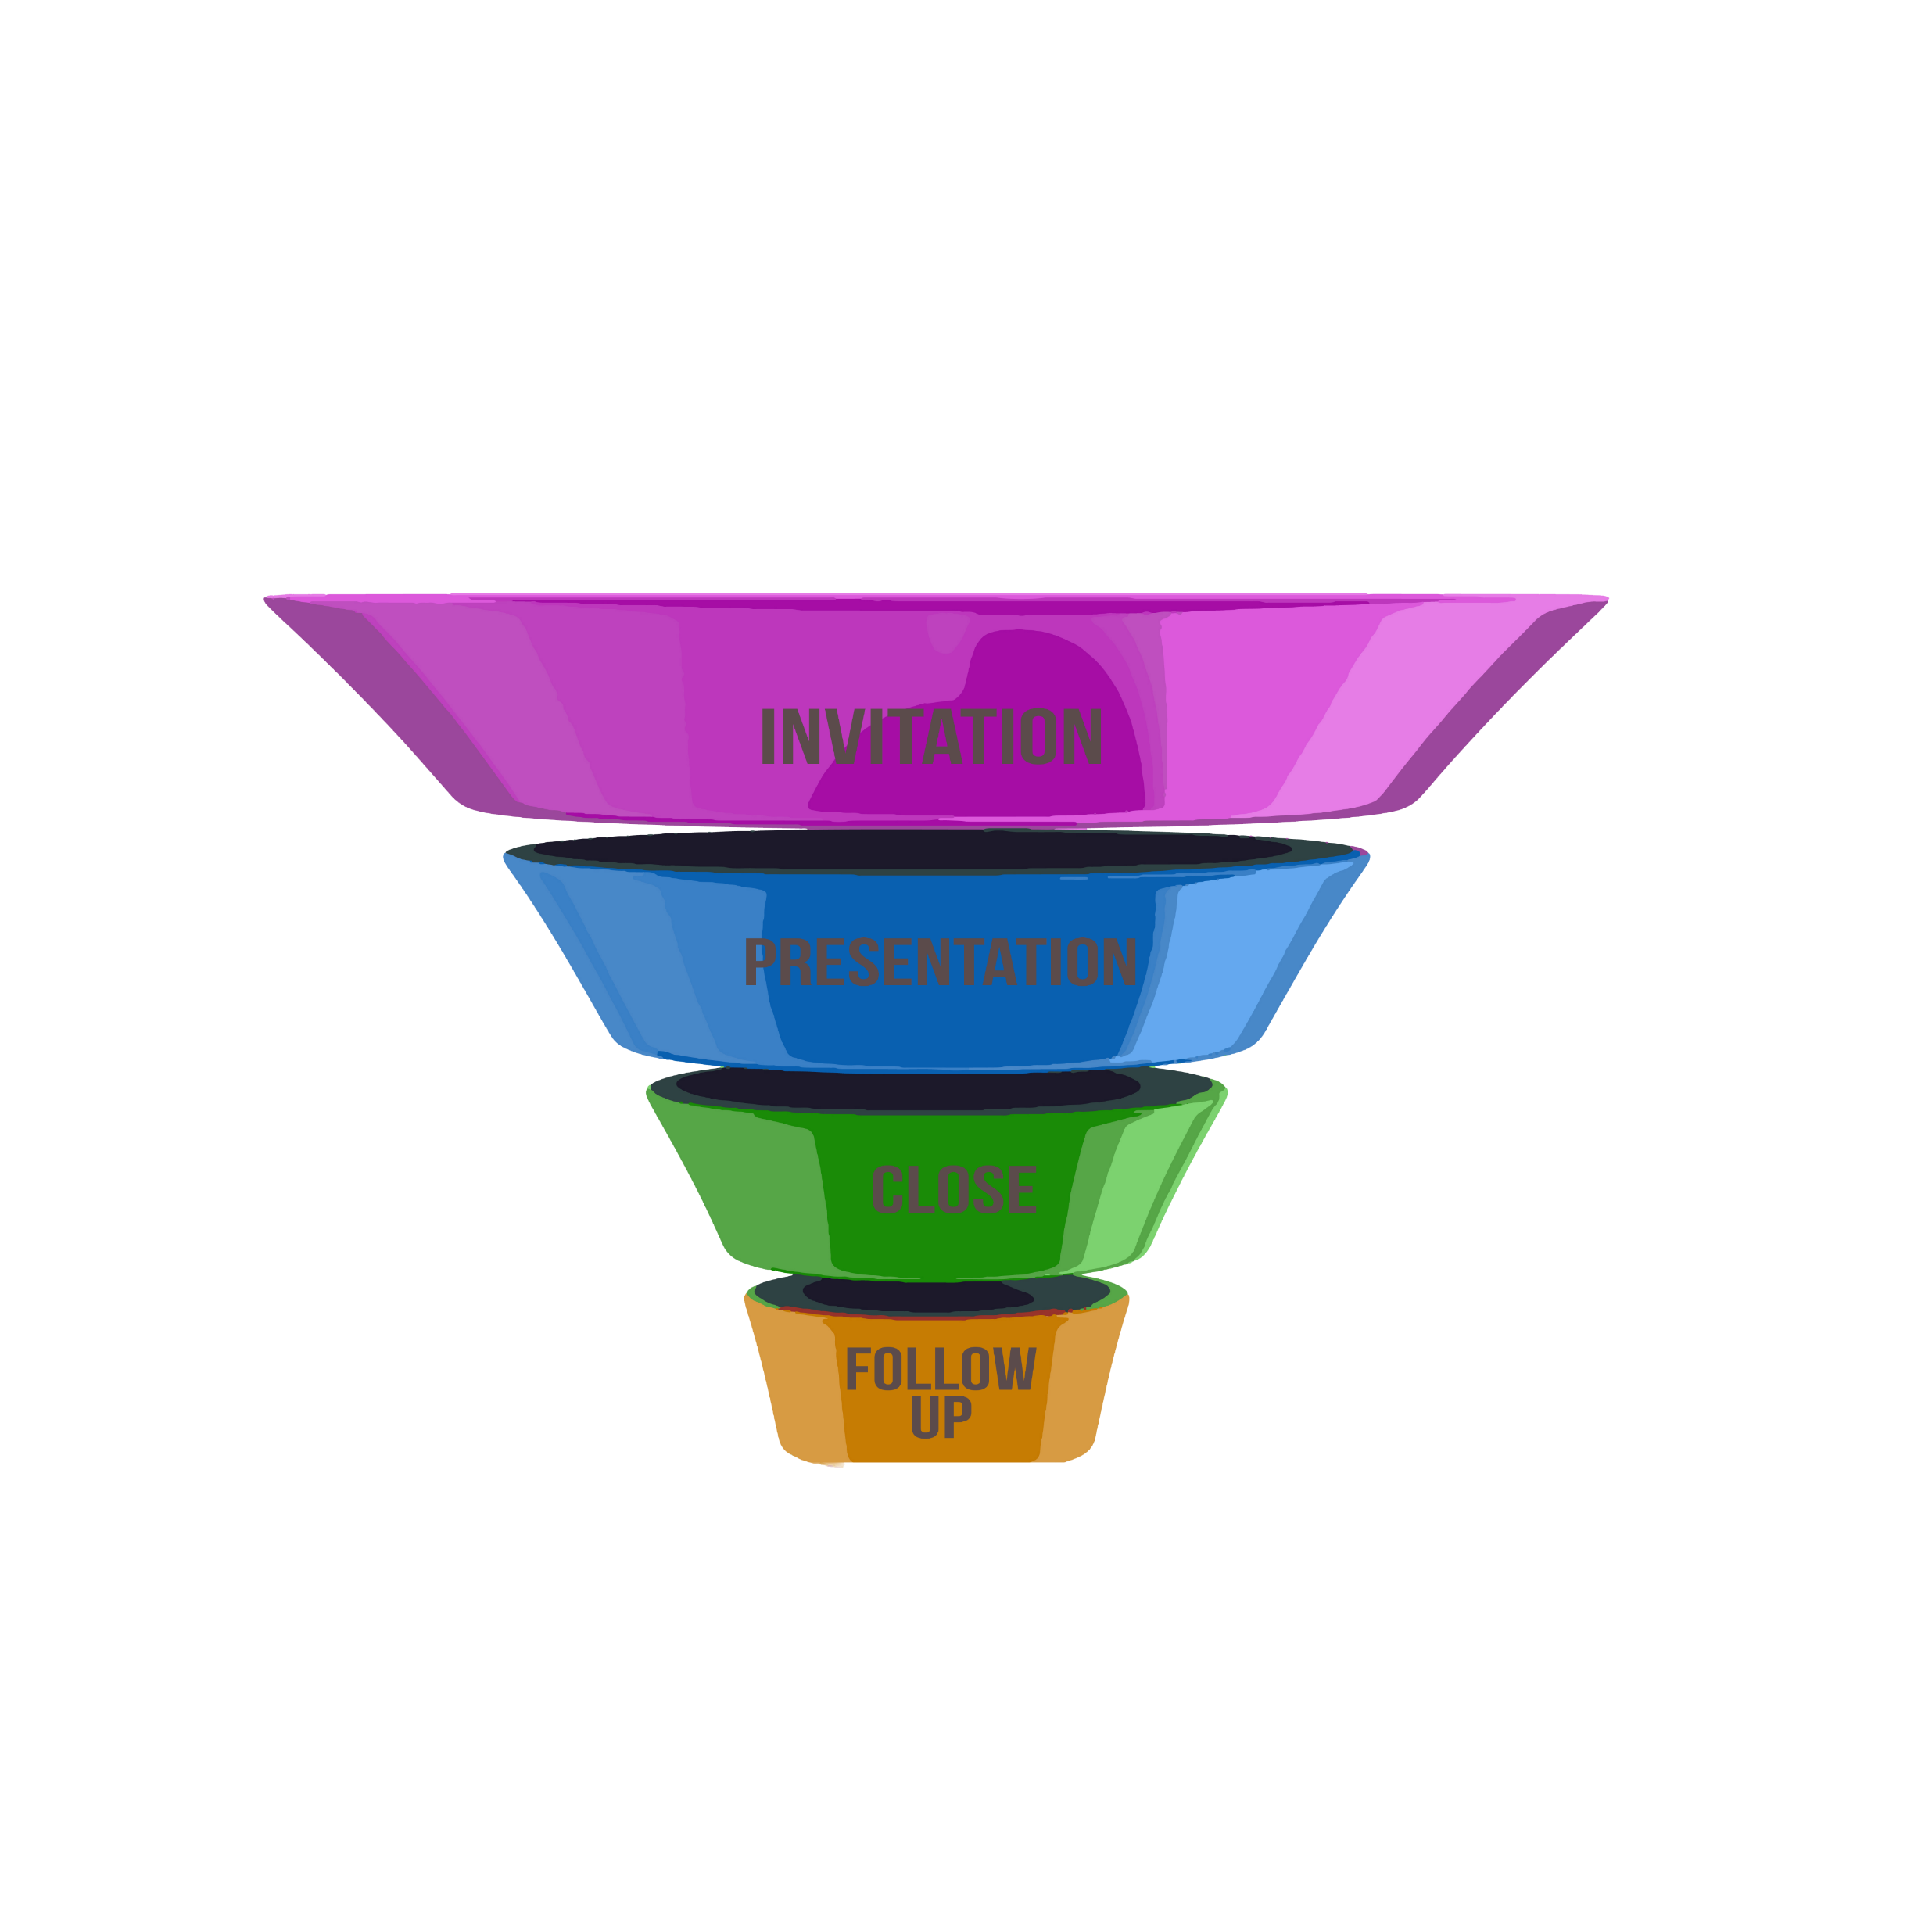
FOLLOW UP
FUNNEL
Warm Market
Contact List
Leak Point
If you input warm market contacts list through
Your sales the funnel properly by correctly
Executing the
Invitation | Presentation | Close | Follow up
If your results are not what you expect you will be able to see where people are leaking out of the funnel and make the corrections quickly
Leak Point
Leak Point
Leak Point
Referral
Natural Leakage
(Not Interested)
Customer
Business
Partner

Slide 6
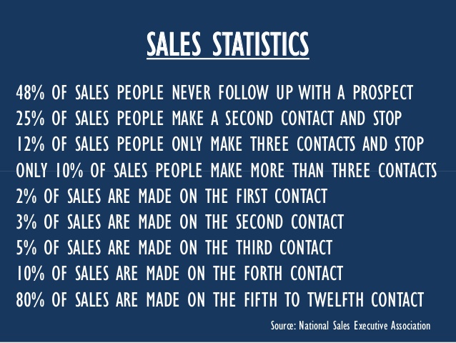

Slide 7
CONCEPT #1: DO WHAT YOU SAID YOU WOULD DO…
Run your business through a physical or electronic calendar.
Be the person who does what they say they are going to do.
If you say you’re going to follow up at a specific time or in a specific way, DO IT!
Keep a Calendar
Be Timely
Respect Other’s Time

Slide 8
CONCEPT #2: BOOK A MEETING FROM A MEETING – BAM-FAM
The only reason to have an exposure is to set up the next exposure… BAM-FAM
It takes an average of 4-6 exposures for people to join but can take more than 10. So be patient… but persistent.
When presenting the first exposure - Set up and schedule the next exposure. Meaning your follow up call.
Find a reason to follow up with people – keeping them engaged.

Slide 9
Making the follow
up Phone Call
“You are going to ask them if they reviewed the material.
If they say “No they didn’t have a chance to review the material”
Remain a professional - do not get frustrated or show displeasure.
Respond. I understand sometimes life gets busy. When do you think you could do it – For sure, for sure.

Slide 10
FOLLOW UP FREQUENCY
How long do you follow up?
You continue to follow up until they sign up!
Once a week for a month
Once a month for a year
Twice annually

Slide 11
Exposure “Tipping Point”
People believe the purpose of the exposure is to get them signed up. The purpose of the exposure is to set the next exposure.
It takes time and multiple exposures to build trust and confidence in your program. With each exposure, you are adding more weight to the scale until you TIP the scale over and they are ready to take advantage of your opportunity.
MULTIPLE EXPOSURES WILL LEAD TO CLOSURES
3
Pique Prospects interest
Shoot them through mobile app
Follow up – check their temperature
Invite them to zoom presentation
Three way phone call with upline
IMV – State of the PlanNet – Team Call
Validation Call – Third Party Validation – Articles, videos
Travel Party

Slide 12
EXAMPLES OF TOOLS & EXPOSURES
LIVE WEBINAR
1 ON 1 MEETING
VIDEO FROM PLANNET APP
STATE OF THE PLANNET ZOOM
PLANNET EVENTS

Slide 13
EXAMPLES OF TOOLS AND EXPOSURES
SUPER SATURDAY
PLANNET BASIC TRAINING
COMPANY INTERNATIONAL LOCKERROOM
NATIONALCONVENTION
ON DEMAND CALL

Slide 14
CONCEPT #4: CONDENSE THE EXPOSURES
It is easier to build fast than slow. Instead of calling 10 people in a week it is easier to call 10 in a day.
Be brief and say less to more people.
People are busy, schedule exposures close together to keep their interest and engaged in the process.

Slide 15
QUESTIONS & OBJECTIONS
Our goal is to Educate and Help them to understand.
OLD TACTIC - FEEL/FELT/FOUND
Reassure them You had the same doubts, questions, or fears
and you overcame them.
“I KNOW HOW YOU FEEL. I FELT THE SAME WAY.
BUT HERE IS WHAT I FOUND.”

Slide 16
LIMITING BELIEFS: COMMON OBJECTIONS CONSIST OF…
1
2
3
4
Limiting Beliefs
I’m not a salesperson
I don’t know anyone
I’m too old / too young /
have no experience
“I know what you mean. I have a friend who had that exact problem and
let me tell you their story.”

Slide 17
02
SKILL 4: FOLLOW UP
COMPLETED

