Slide 1
A PlanNet Marketing Training
7 SKILLS TO BECOME A
PROFESSIONAL NETWORK MARKETER
Skill #5: Helping Prospects
To Become Business
Partners

Slide 2
7 SKILLS TO BECOME A
PROFESSIONAL NETWORK MARKETER
Go Pro Book – by Eric Worre
PROMOTING
EVENTS
HELPING
PARTNER GET STARTED
5. HELPING
PROSPECT TO BECOME A PARTNER
4. FOLLOWING
UP
3. PRESENTING
OPPORTUNITY
2. INVITING
PROSPECTS
1. FINDING
PROSPECTS

Slide 3
02
A NETWORK MARKETING PROFESSIONAL
A person who is an expert at the skills required to build a large and successful Network Marketing organization

Slide 4
PREVIOUS SKILLS WE HAVE DISCUSSED
We wish for you that you decide to become a Network Marketing Professional
02
04
Skill 02
Skill 04
Inviting Prospects
The Fortune is in the Follow up
01
03
Skill 01
Skill 03
Finding Prospects
Presenting Your Product

Slide 5
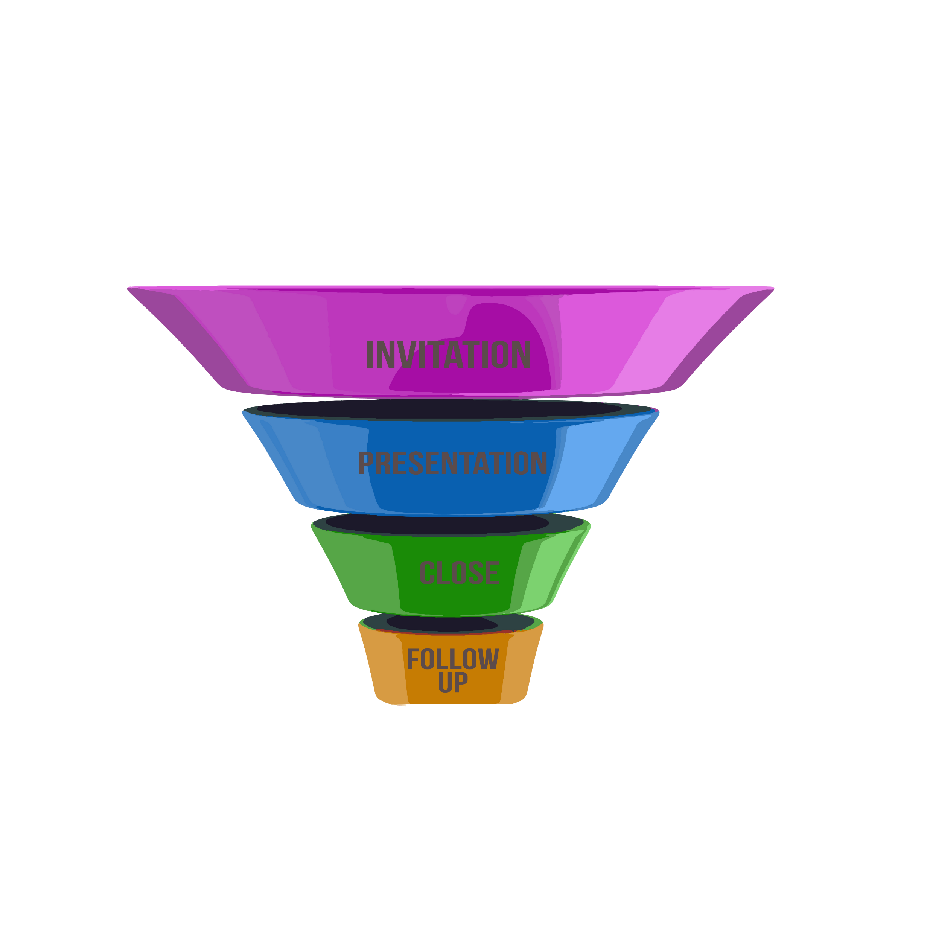
FOLLOW UP FUNNEL
Warm Market
Contact List
Leak Point
If you input warm market contacts list through the funnel properly by correctly Executing the
Invitation | Presentation | Close | Follow up
If your results are not what you expect you will be the funnel and make the corrections quickly
Leak Point
Leak Point
Leak Point
Referral
Natural Leakage
(Not Interested)
Customer
Business
Partner

Slide 6
AS A PROFESSIONAL YOU HAVE THREE POSSIBLE OUTCOMES
BECOME YOUR TRAVEL CLIENT
BECOME BUSINESS PARTNER
RECEIVE QUALIFIED REFFERALS
LEAD WITH THE BUSINESS, MISS WITH THE SALE

Slide 7
KEY TO A SUCCESSFUL CLOSE
Getting them to enroll as your business partner
POSTURE UP!
YOUR WORDS WILL BREED CONFIDENCE
NO DOUBT
1% doubt and you are out

Slide 8
REMEMBER THE GOAL
Stop trying to GET people…
Instead, pursue the goal.
Our goal is to EDUCATE and
help them to UNDERSTAND.
And find out if they are
a YES or a NO.

Slide 9
Welcome / Three-way Call
Determine the purpose for the call
The Invite – you can use an expert to share their story and invite prospect to event.
The Close- Use your expert after a presentation is done to get questions answered and create urgency in signing up on the spot.
The Move Along – Your expert can take a prospect who is not ready to decide and invite them to another event.
The Promotion – Your upline can be used to convince your downline to do something. (Host their PBR, Attend convention, Get on a team zoom or conference call.)
The Welcome – The prospect has just joined, give them an introduction to their support team and to reinforce their great decision.

Slide 10
THE PRO’S CLOSE
Emotionally detach yourself from the outcome.
Be assumptive in your approach.
Promote yourself…You get ME! They need to know that you will support them.
Be prepared.
Let questions be your most POWERFUL tool:
- Did it make sense to you?
- What did you like best?
- Pretty exciting, isn’t it?
- Can you see how this could be an opportunity for you?

Slide 11
The key to success is a combination of
Emotionally detach yourself from the outcome.
Having good posture – Your words and your actions. Posture is your stance, your disposition, your ability to project confidence.
Asking good questions – taking on the role of a consultant. You are there to advise and consult. Asking the right questions leading them to the decision to do what is in their best interest.

Slide 12
AMATEUR
You are needy.
Emotionally attached to prospects response.
Come across as desperate and pushy.
You are trying to get them.
Assumption that they are not going to be interested.
Not properly prepared.
Project a lack of belief and professionalism.

Slide 13
PROFESSIONAL
Strong posture you realize you have the opportunity.
You are emotionally detached from the outcome. {Yes or No}
Your Goal is education.
You are not trying to get anyone, you are attempting to HELP.
You are very assumptive that they will move forward.
You are always prepared. You have everything they need to get started.
You ask question after question, after question.

Slide 14
BEING A CONSULTANT
As a consultant your job is to help out and advise on the best outcome or solution for them.
Ask the right questions?
Did that make sense to you?
What did you like best about what you just saw?
Assumptive: It is pretty exciting, isn’t it?
Can you see how this would be a total benefit for you?

Slide 15
ASKING GOOD QUESTIONS
Let me ask you a question?
On a scale of 1 to 10, with one meaning you have zero interest and 10 being you are ready to get started right now, where are you?
If anything other than 10 :
Ask what would it take to move you to a 10
BAM-FAM Lead them to the next exposure

Slide 16
THE 4 QUESTION CLOSE
1
2
3
4
How much $$$ would
you want to earn?
How much time
can you commit for
goal ?
How long would you
do it to get that income?
If I could show you how to develop
an income of (their answer to #1), working (their answer to #2)
hours per week, over the
course of (their answer to #3),
would you be ready to get started?

Slide 17
THE ULTIMATE CLOSE
What do you like best about what you do?
If you could change one thing about what you do, what would that be?
If you could pay yourself more on a monthly basis, how much more would you need to? ($500, $1000, $2000)
What would you do with that extra income, that you currently aren’t able to do? _______ (Be assumptive help them dream)
Are these goals and dreams important to you?
Do you see yourself, being able to accomplish these goals and dreams anytime soon, with what you are currently doing? WFA
If you saw a way that you were able to and you see that you
can 1,2,3,4,and 5...what would stop you from taking advantage

Slide 18
02
SKILL 5: HELPING PROSPECTS TO BECOME
BUSINESS PARTNERS
COMPLETED

