Slide 1
THE ART OF EDIFICATION

Slide 2
EDIFICATION
Edification is a critical component in the day-to-day operations of a professional network marketer.
Edification is not widely used or mastered because most do not understand its power or purpose in building their business.
Edification is necessary for third party validation and is a crucial phycological part of the buy in process. It is how you get: someone on a 3 way call, someone on a zoom, someone to a meeting or to get someone to join you. It is your skill and ability to edify.

Slide 3
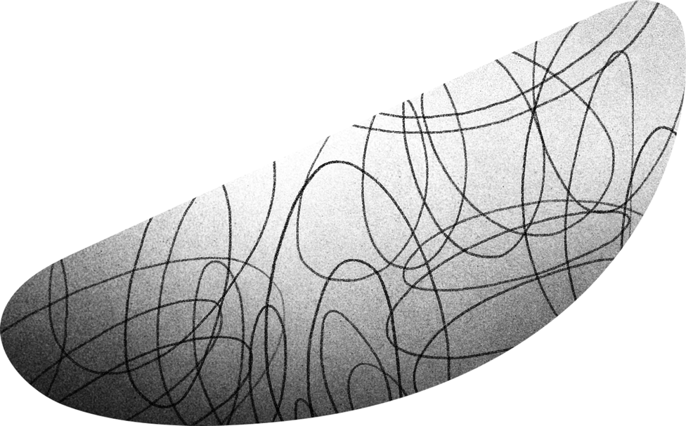
YOU SET THE STAGE
PAINT THE PICTURE, CREATE THE EXCITEMENT FOR THE BUY IN.
RED
BLUE
GREEN
YELLOW
He loves to make money
He loves to have fun
He has 100% of the information
He loves to help people
*Always attempt to get bio information from your upline,
success partner or presenter.

Slide 4
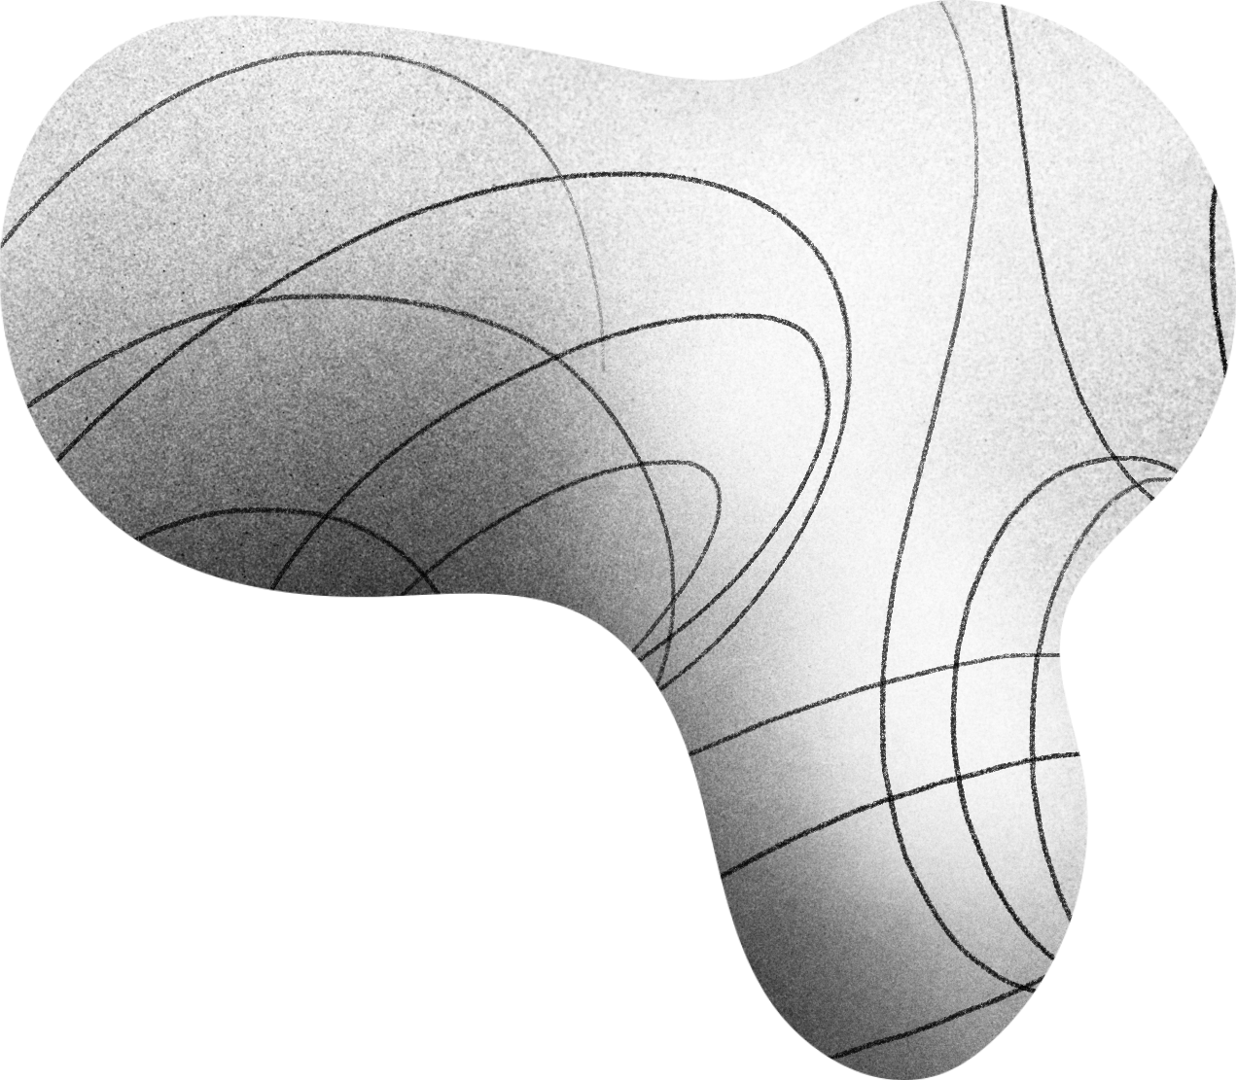
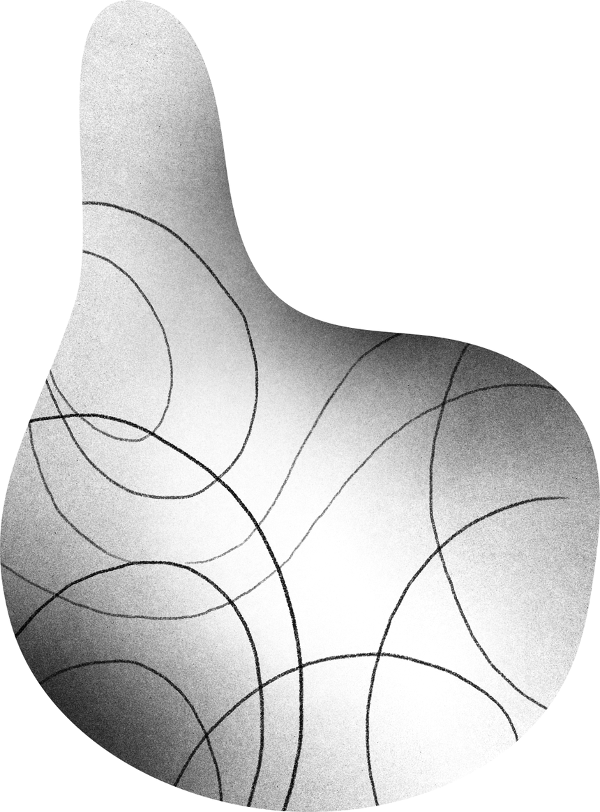
EDIFICATION
Edification informs and excites prospects, for who they’re going to talk to and for what is to come. Edification builds respect for your expert to work for you!

Slide 5
01
Edification gives Information. People need to know who they are speaking with. And why do they have the authority to speak? Documentation beats conversation.
EDIFICATION
Edification excites! People make emotional decisions more than they make logical decisions. The better you edify your expert or the project, the more your prospect will get excited about what you have to offer. (BELIEF)
02
Edification projects a vision, validates and sets the stage. People must know it's bigger than you. Who else is winning? Edification gives social proof and validates through real life success stories.
03

Slide 6
Leadership
25%
Company
25%
YOU SHOULD EDIFY…
Timing & Opportunity
25%
Industry
25%

Slide 7
THE DANGER IN NOT USING EDIFICATION
When you are lazy in edification you devalue your business, under stimulate, you uninform, you don’t create a good duplicatable culture, you don't paint the proper picture and you cut your chances of closing by 80%.

Slide 8
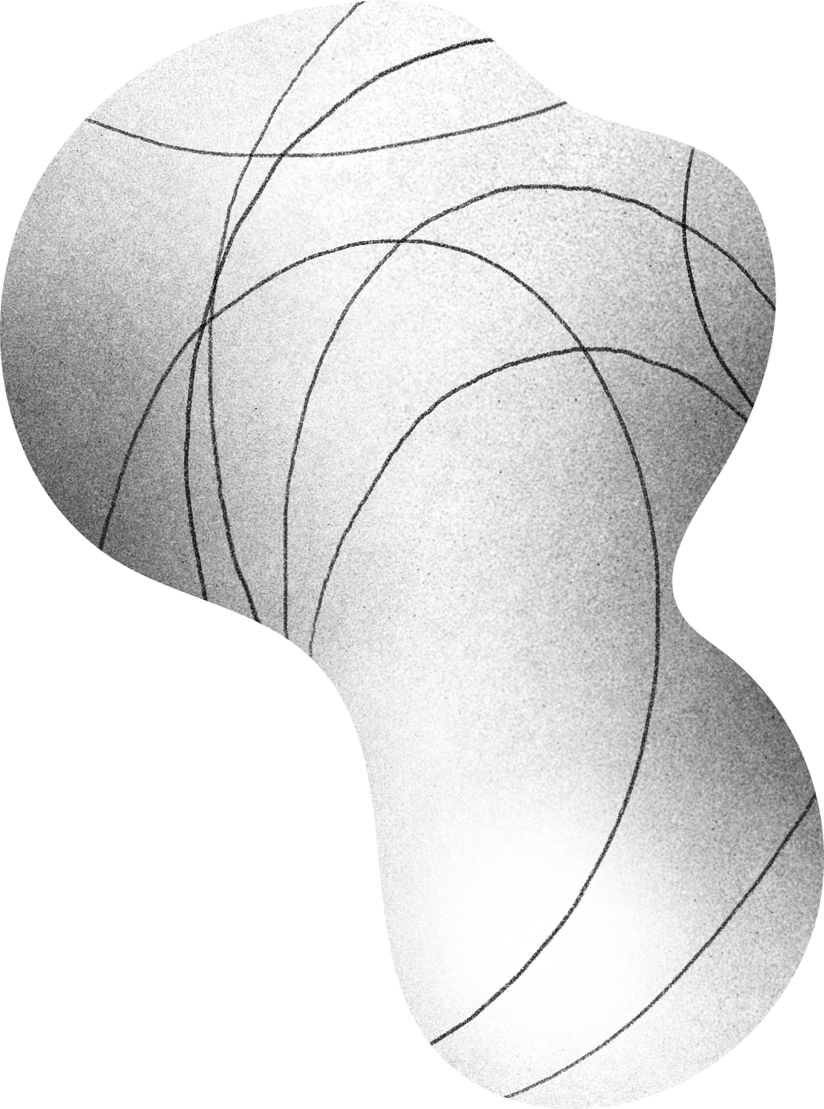
BOTTOM
LINE.
Edification is a crucial and key component in the unification and duplication in an organization if it is going to grow.

Slide 9
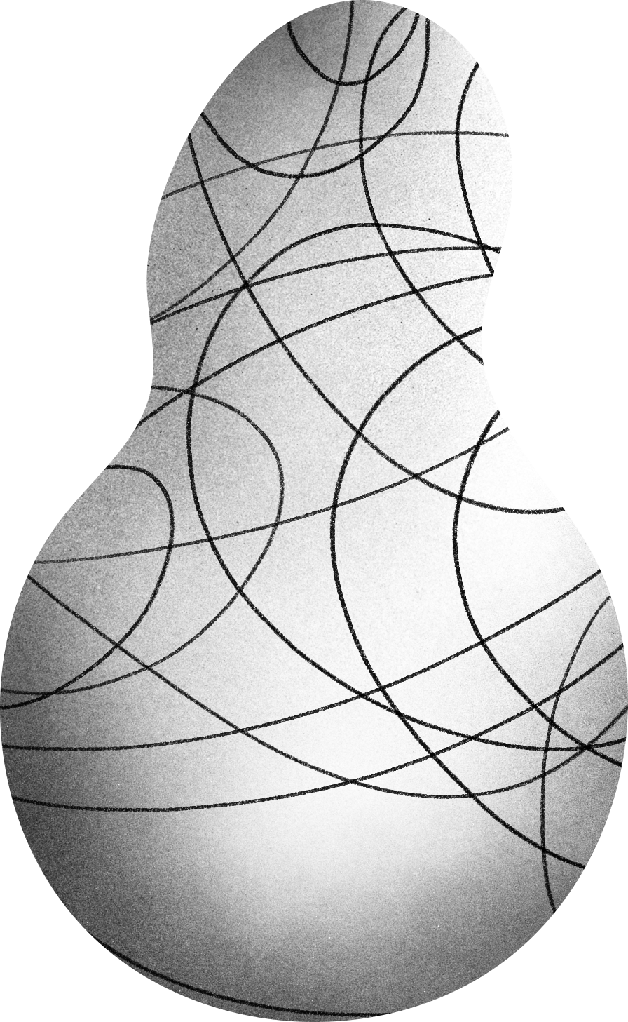
THANK YOU!
For Your Time

