Slide 1
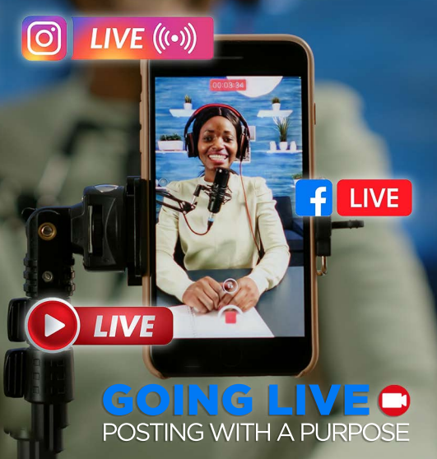
Mazimizing Your Convention Experience
SOCIAL MEDIA STRATEGIES BEFORE - DURING - AFTER

Slide 2
Clean Up Your Storefront
Professional Profile
Public Profile
Quality Profile picture
Billboard Ready Posts [If you wouldn’t want it posted on a billboard, don’t say it]
What Are You Selling?

Slide 3
Creating Content
Social Media Stories
Live Video
B Roll Footage
Record [Edit and post later]
Create a Blog / Vlog mini series
Post Consistently! [1 and done doesn’t work online]
Engage With Other Peoples Content

Slide 4
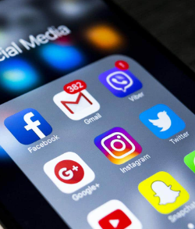
Pre Convention Posts
ENGAGEMENT POSTS FOR COMMENTS
Tell people that you are heading to Orlando and want to know the top____
Restaurants | Activities | Team Building Exercises etc…
POLLS:
Have people vote on the outfits that you are bringing to convention
WHO, WHAT, WHERE, WHEN, WHY
BEHIND THE SCENES
Packing, Traveling, Reading a Tim Grover Book
Highlight conventions from previous years
COUNTDOWN POSTS
SPOTLIGHT TIM GROVER
WHAT QUESTIONS DOES YOUR AUDIENCE HAVE [Get Convention Attendees to answer them]

Slide 5
Wednesday
Hotel Room / Property Tours
Excitement Posts: What are you looking forward to? What are you getting ready to experience?
Start Spotlighting your business partners
Take pics on Millionaires Row before it gets too crowded

Slide 6
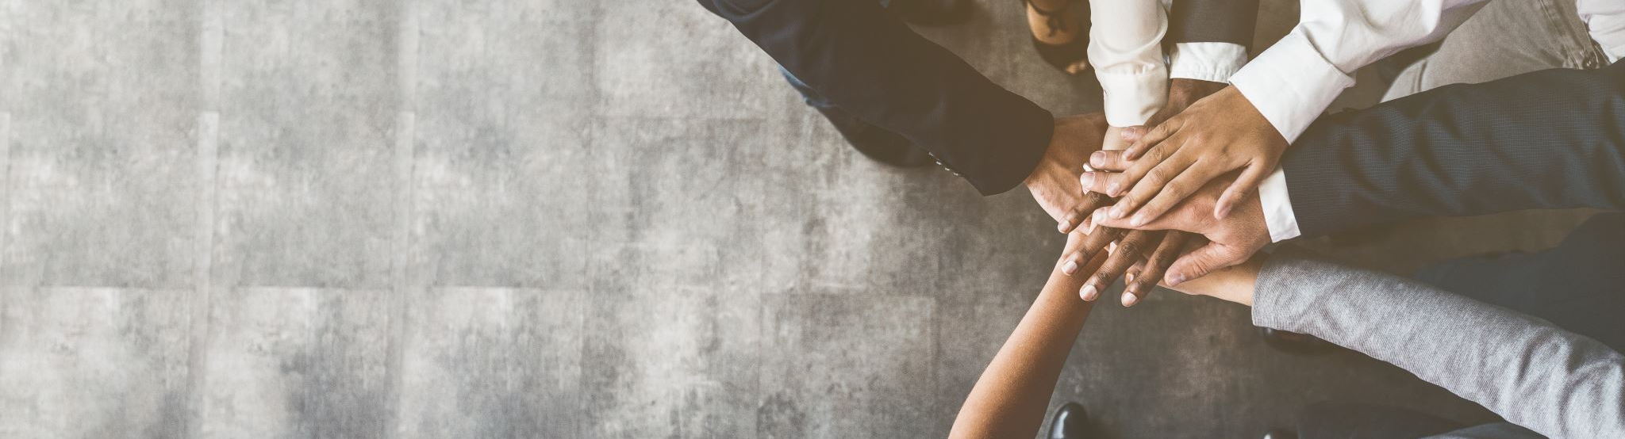
Thursday
GRWM [Get Ready With Me]
Share Success Stories
Continue Spotlighting Your Business Partners
Recap your day
Biggest Takeaways
How has your life changed already

Slide 7
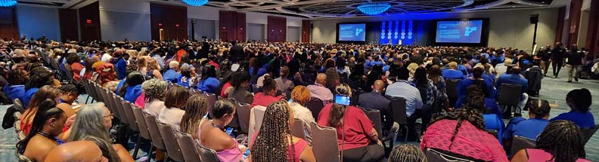
Friday
Highlight the Fireball Awards
Share Success Stories
Highlight Team Breakout Sessions
Spotlight Your Business Partners
Give a recap of your day

Slide 8
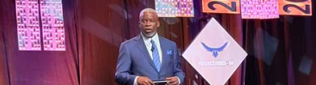
Saturday
Share key takeaways from Mr. Bradley and company leaders
Share key takeaways from Tim Grovers’ Session
Highlight awards ceremonies
Declare which awards you are going to receive next year
Share PlanNet Cares campaign
Follow Up With HOT PROSPECTS while at convention!!
“I’ve spent the morning with the top leaders in my company and I cannot get you / our last conversation out of my head. I have a small break tonight at ______. Can we jump on the phone for a few minutes? I need to talk to you.”
Share 2025 TEN YEAR Convention Announcement

Slide 9
Sunday
Travel Content [if you’re leaving FL]
Property Tours [pools / waterpark etc…]
BLACK OUT Event Content
Interview BPs
What are you thankful for?
Follow Up With Prospects
Invite to the Monday Morning IMV

Slide 10
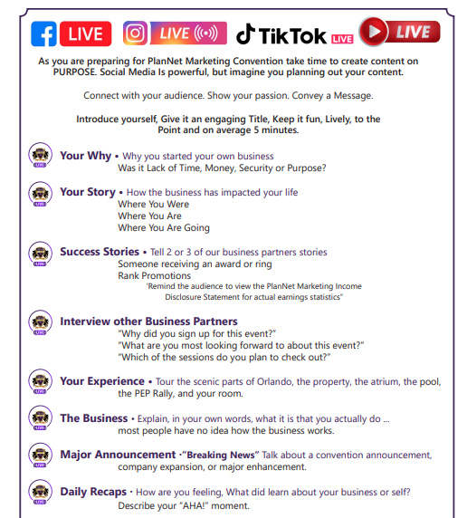
TIPS WHEN GOING LIVE
Always Have A CALL TO ACTION!

Slide 11
AFTER CONVENTION
Create a recap/highlight video and post throughout social media
PicsArt / CAPCUT
How has your life been changed / How can you change someone’s life
Relaunch your business!!
You are different now--- and the world needs to know!
Follow up with Contacts
“I was at an event last week that changed my life, and it made me think of you. Do you have a few minutes today to speak by phone?”
Thank You Posts

Slide 12
BONUS TIPS
Team Photos
Figure out your times NOW
Pick the camera man/woman ahead of time!
Bring a Tripod
Sit at the front of the room and take photos/video with the crowd behind you
Have your interview questions easily accessible (Ex: in the notes of your phone)
Bring a portable battery charger
Stay Positive and Have FUN!

